Slide 1
Classification
Introduction and KNN

Slide 2
Classification Using Distance
Place items in class to which they are “closest”.
Must determine distance between an item and a class.
Classes represented by
Centroid: Central value.
Medoid: Representative point.
Individual points
Algorithm: KNN

Slide 3
K Nearest Neighbor (KNN):
Training set includes classes.
Examine K items near item to be classified.
New item placed in class with the most number of close items.
O(q) for each tuple to be classified. (Here q is the size of the training set.)

Slide 4
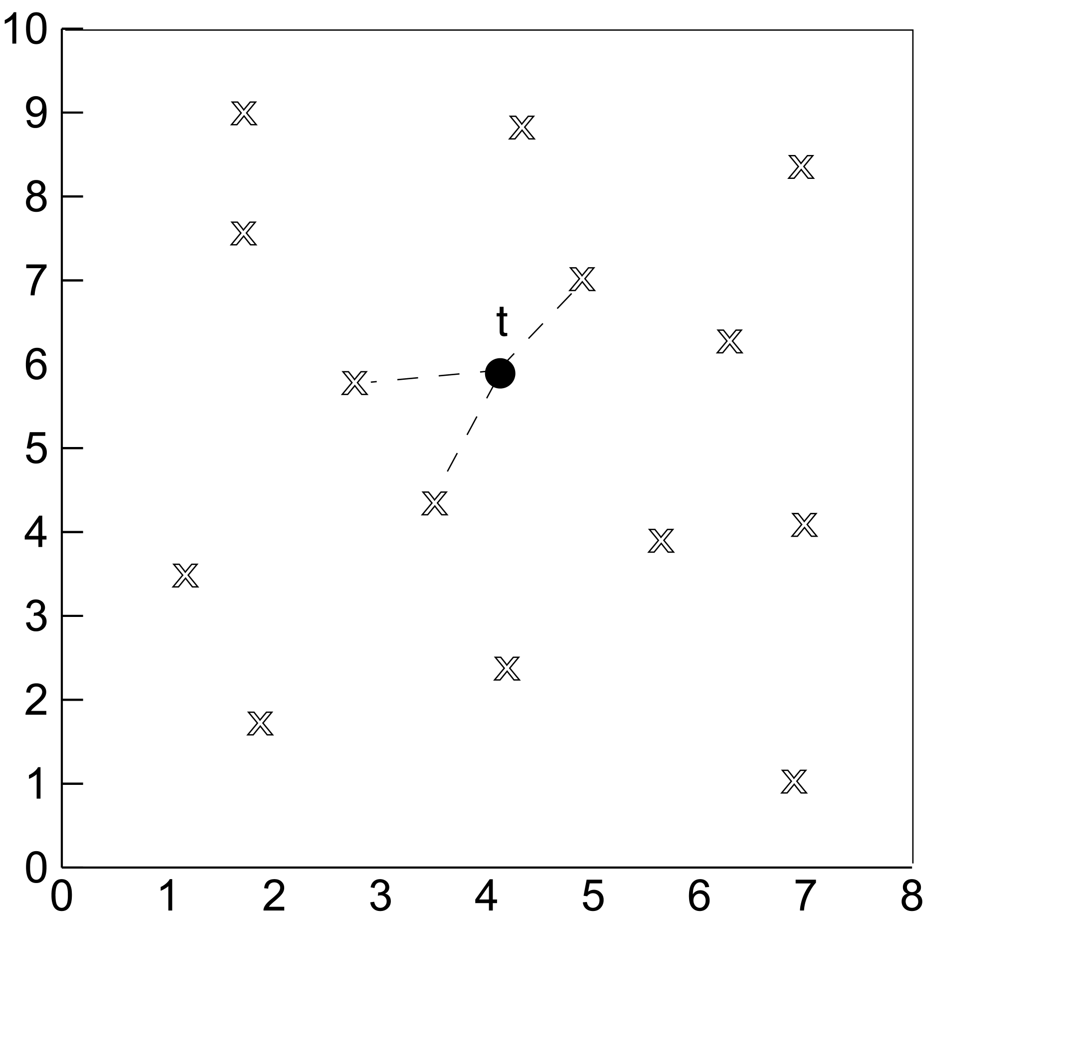
KNN

Slide 5
1-Nearest Neighbor
One of the simplest of all machine learning classifiers
Simple idea: label a new point the same as the closest known point
Label it red.

Slide 6
k – Nearest Neighbor
Generalizes 1-NN to smooth away noise in the labels
A new point is now assigned the most frequent label of its k nearest neighbors
Label it red, when k = 3
Label it blue, when k = 7

Slide 7
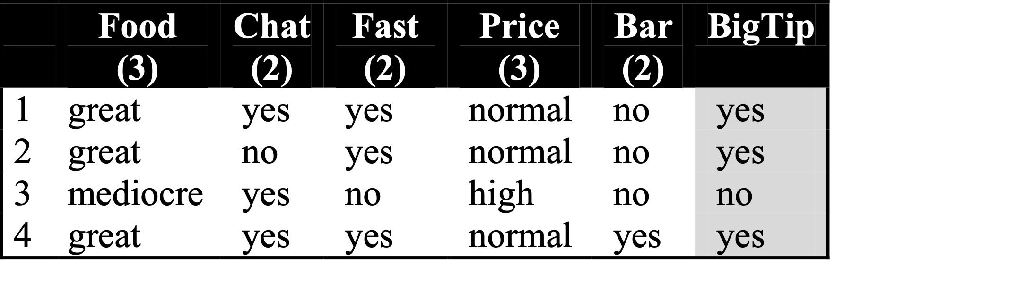
KNN Example
Similarity metric: Number of matching attributes (k=2)
New examples:
Example 1 (great, no, no, normal, no)
Example 2 (mediocre, yes, no, normal, no)
Yes
→ most similar: number 2 (1 mismatch, 4 match) → yes
→Second most similar example: number 1 (2 mismatch, 3 match) → yes
Yes/No
→ Most similar: number 3 (1 mismatch, 4 match) → no
→Second most similar example: number 1 (2 mismatch, 3 match) → yes
Notes:
Distance metric: Number of matching attributes
Example 1:
Most similar example: number 2 (1 mismatch, 4 match) -> classify yes
Second most similar example: number 1 (2 mismatch, 3 match) -> classify yes
Example 2:
Most similar example: number 3 (1 mismatch, 4 match) -> classify no
Second most similar example: number 1 (2 mismatch, 3 match) -> classify yes/no

Slide 8
Selecting the Number of Neighbors
Increase k:
Makes KNN less sensitive to noise
Decrease k:
Allows capturing finer structure of space
Pick k not too large, but not too small (depends on data)

Slide 9
Disadvantages of KNN
Need distance/similarity measure and attributes that “match” target function.
For large training sets,
Must make a pass through the entire dataset for each classification. This can be prohibitive for large data sets.
Prediction accuracy can quickly degrade when number of attributes grows.
Simple to implement algorithm;
Requires little tuning;
Often performs quite weel!
(Try it first on a new learning problem).
Notes:
Need similarity measure and attributes that “match” target function
predicting a person’s height may depend on different attributes than predicting their IQ

Slide 10
Advantages of KNN
Simple to implement algorithm
Requires little tuning
Often performs quite well!
Notes:
Need similarity measure and attributes that “match” target function
predicting a person’s height may depend on different attributes than predicting their IQ

Slide 11
Example - Tissue Paper Good or Bad
X1 = Acid Durability | X2 = Strength | Y = class
7 | 7 | Bad
7 | 4 | Bad
3 | 4 | Good
1 | 4 | Good

Slide 12
K = 3 New Instance = (3,7)
X1 = Acid Durability | X2 = Strength | Distance
7 | 7 | (7-3)^2 + (7-7)^2 =16
7 | 4 | (7-3)^2 + (4-7)^2 =25
3 | 4 | (3-3)^2 + (4-7)^2 =9
1 | 4 | (1-3)^2 + (4-7)^2 =13

Slide 13
Prediction
Nearest Neighbors = 1(Bad),3(Good) and 4(Good)
Prediction = Good

